Slide 1



CLIMADE Africa:
Review progress update
28 March 2023
Dr. Monika Moir and Dr. Houriiyah Tegally
Centre for Epidemic Response and Innovation (CERI), Stellenbosch University https://ceri.org.za | https://climade.health | Twitter: @tuliodna

Slide 2
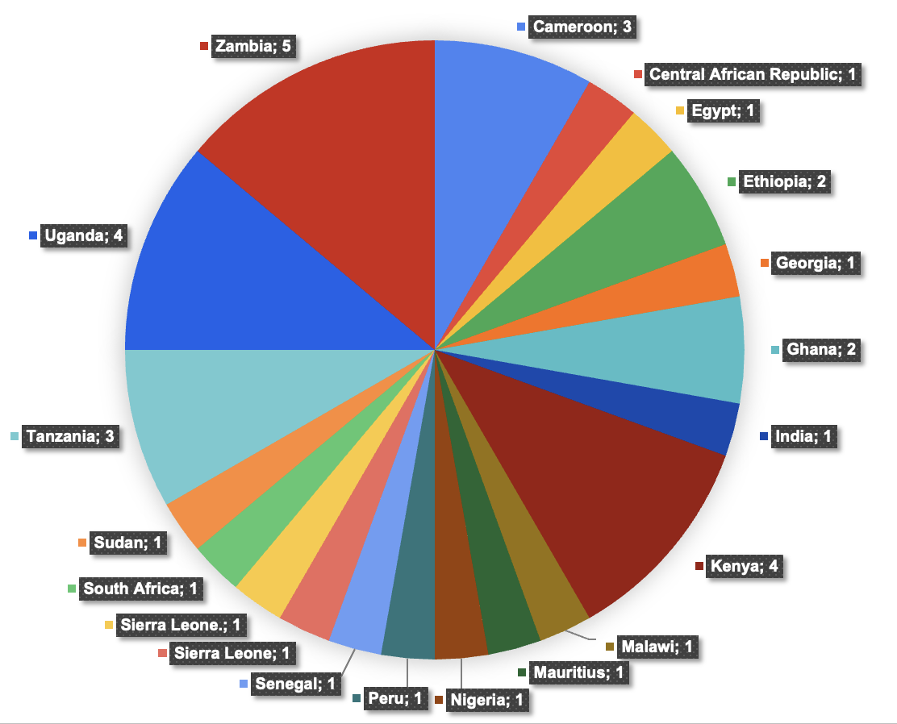
April 2023 Genomics and Bioinformatics Training
11 - 21 April 2023
CERI lab, Tygerberg, Stellenbosch University, Cape Town, South Africa

Slide 3
April 2023 Genomics and Bioinformatics Training
11 - 21 April 2023
CERI lab, Tygerberg, Stellenbosch University, Cape Town, South Africa
Topics covered in this training opportunity
COVID-19 sequencing protocol on ONT
How to adapt the protocol to other pathogens
Introduction to Unix and R
Basecalling and assembly
QC
Submitting to SRA and GISAID
Intro to phylogenetics
Visualizing lineage plots and trees
Writing a report
Notes:
Amplification, master mix, library prep, loading and sequencing

Slide 4
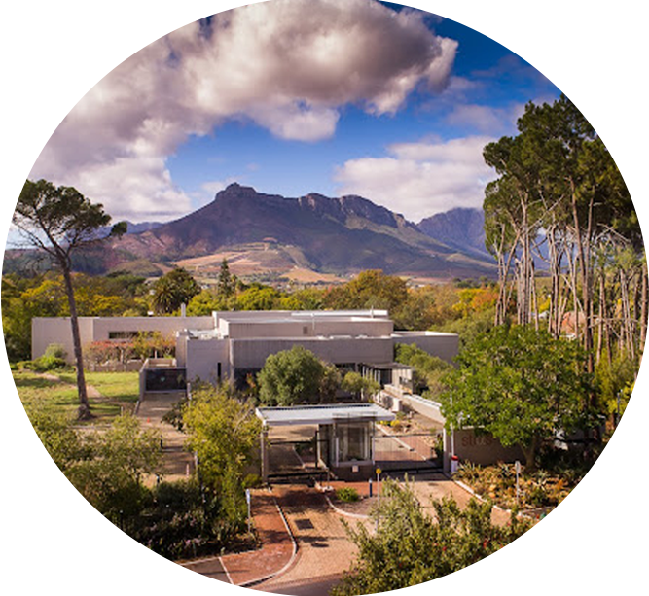


Viral Evolution and Molecular Epidemiology (VEME) Workshop
Apply now!
Deadline: 1st of April
https://veme.climade.health/application/
Programme consists of four separate modules that will provide an overview of the current methods used to analyze the vast data generated by modern DNA sequencing technologies, including:
1-Phylogeny inference;
2-Evolutionary Hypothesis Testing;
3-Next Generation Sequencing;
4-From Trees to Public Health Policy.

Slide 5

Understanding the prevalence and surveillance of climate sensitive vector-borne diseases in Africa
Understand disease prevalence and occurrence of seven key arboviruses across the African continent
Review of seroprevalence studies in humans, vectors, and animals
WHO Afro case reports
Questionnaires completed by Climade Africa Working Group
Map the extent of surveillance efforts for these diseases
Review of seroprevalence studies
Review of genomic studies
Questionnaires completed by Climade Africa Working Group
Identify areas in which disease prevalence is known or likely but genomic surveillance is lacking
Identify the challenges of genomic sequencing across the continent and where access to the technology and skills is required
Sequence stored samples for further analysis to better understand these diseases in Africa

Slide 6
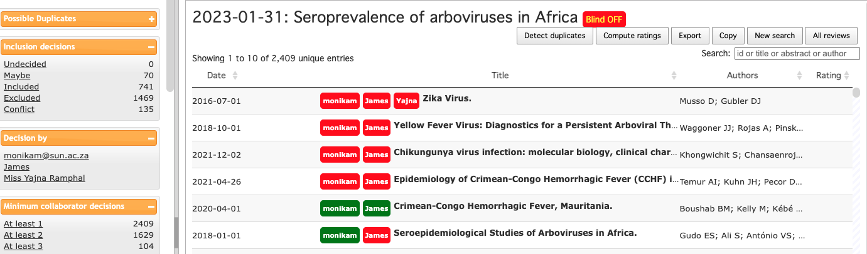
Review of arboviruses in Africa: Seroprevalence and Genomics
Screened ~5000 papers
~840 are relevant for seroprevalence data
~300 papers present genomes sampled from Africa

Slide 7
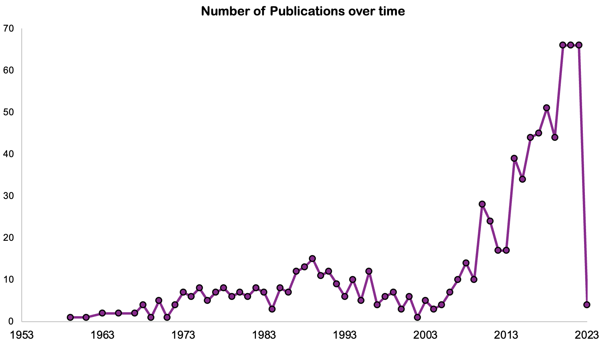
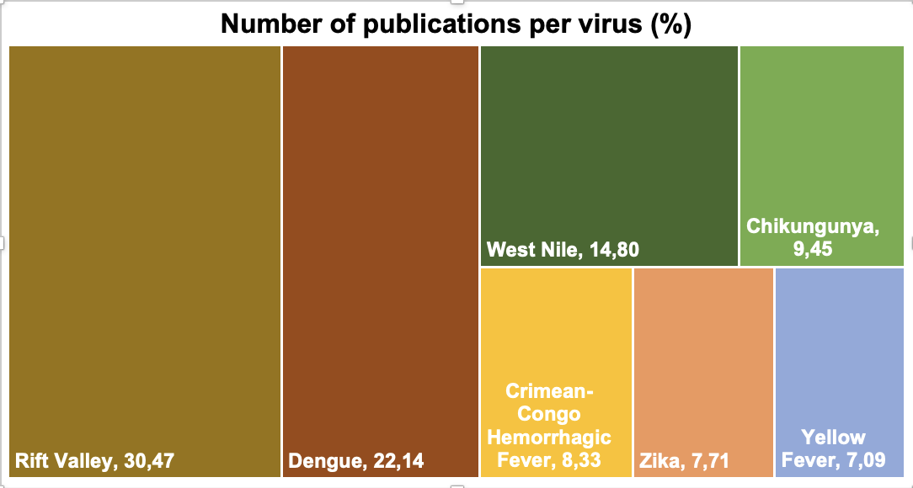
Review of arboviruses in Africa: Seroprevalence

Slide 8
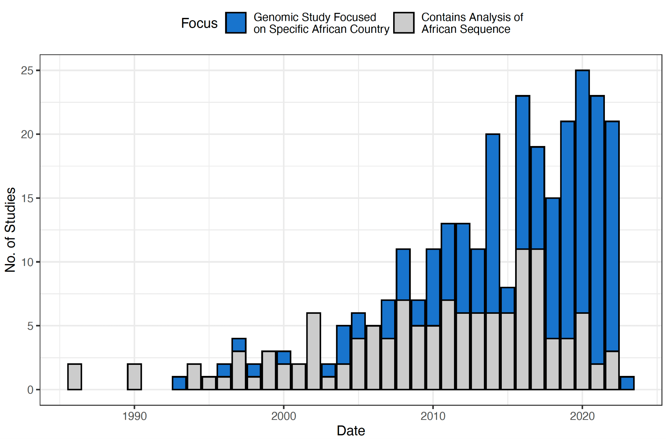
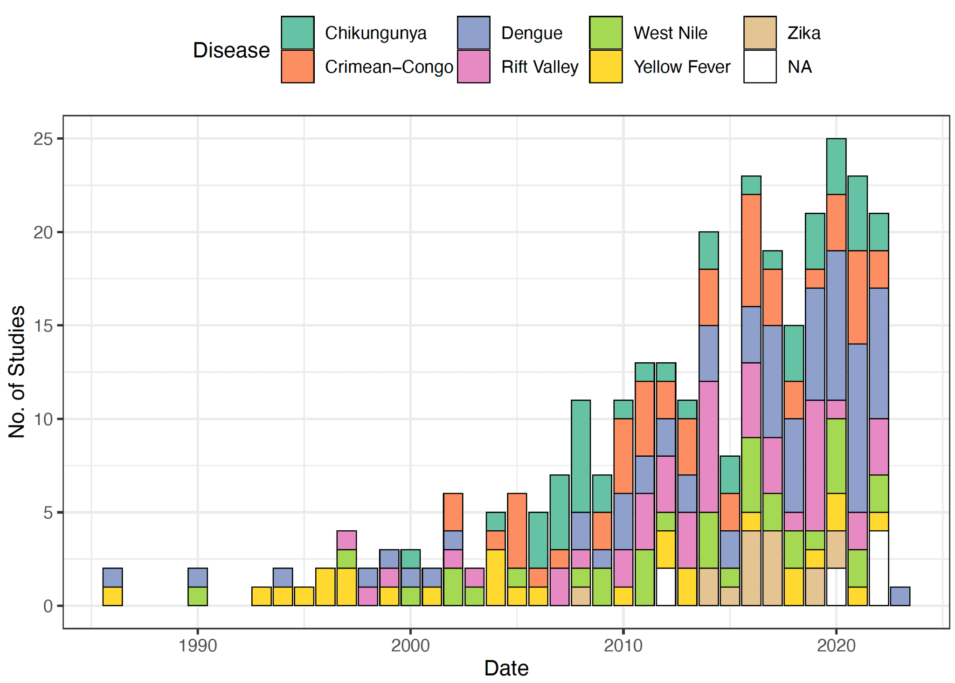
Review of arboviruses in Africa: Genomics

Slide 9
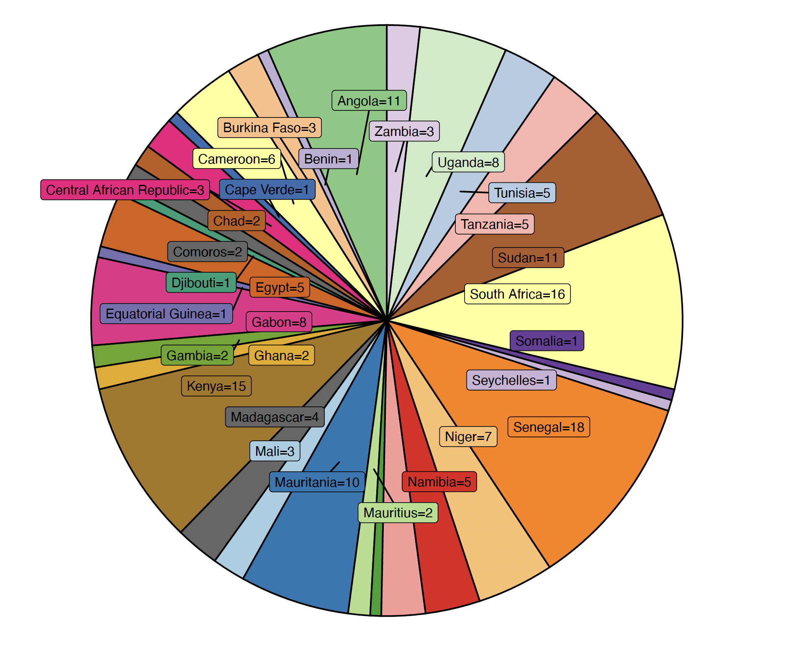
Review of arboviruses in Africa: Genomics

Slide 10
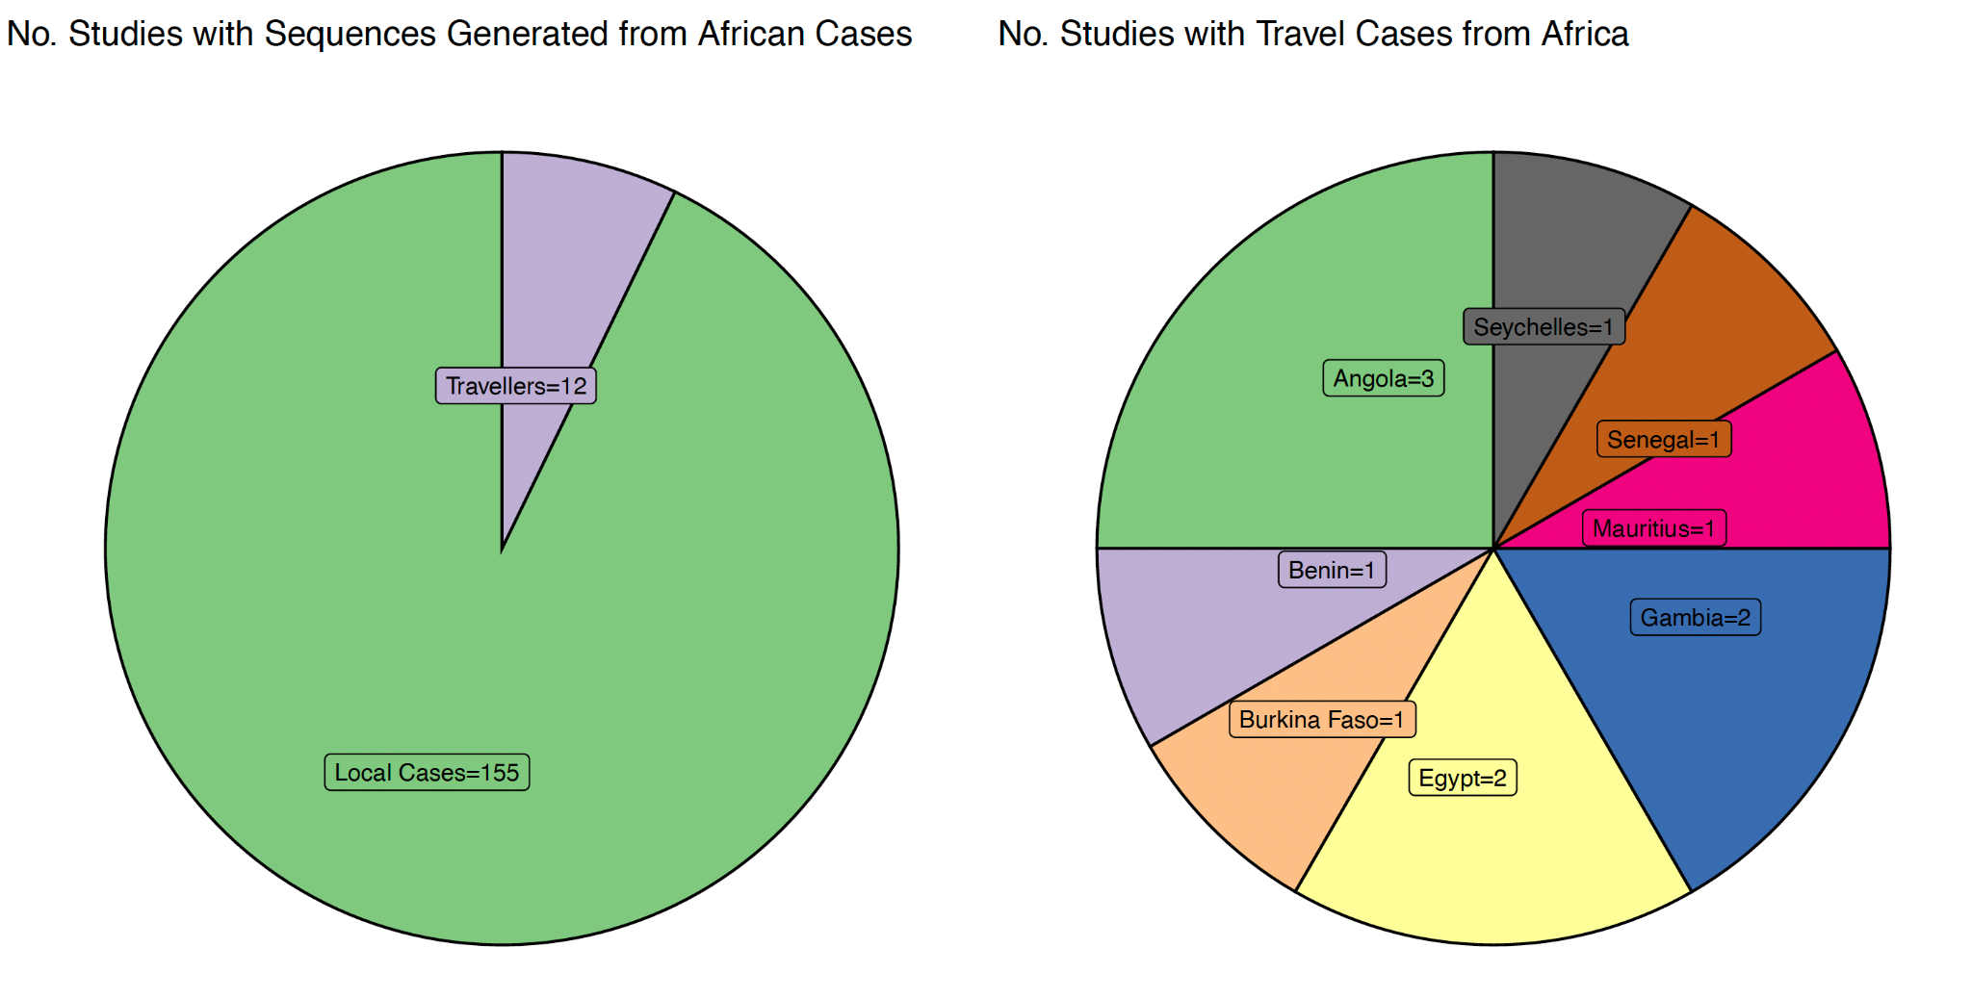
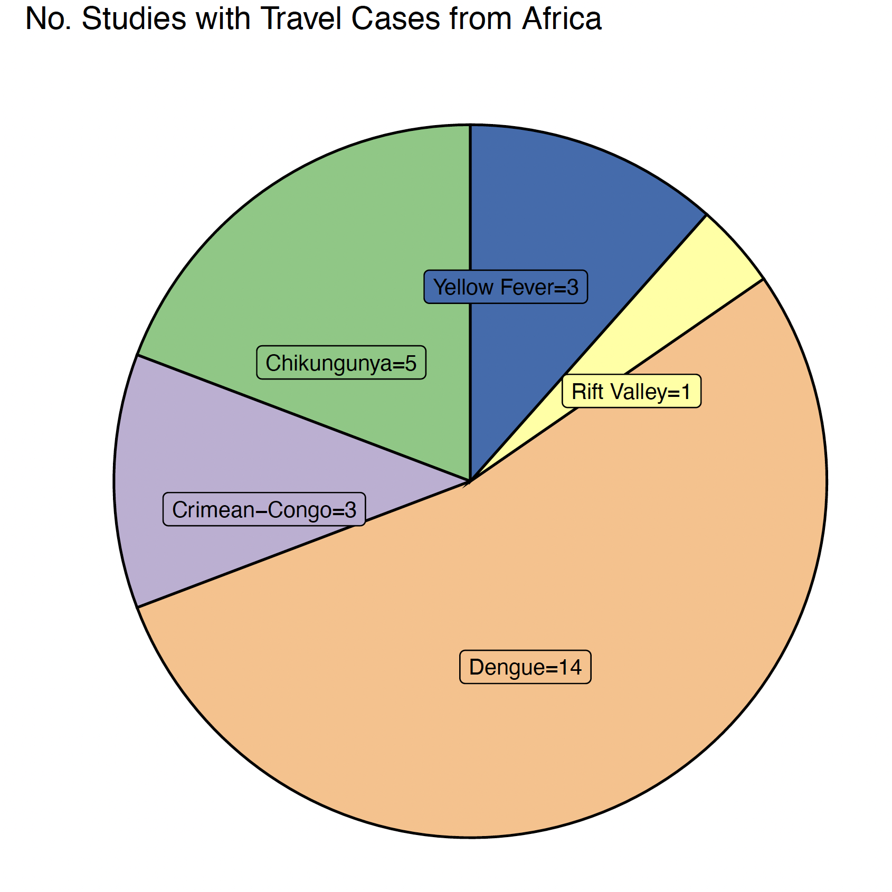
Review of arboviruses in Africa: Genomics

Slide 11
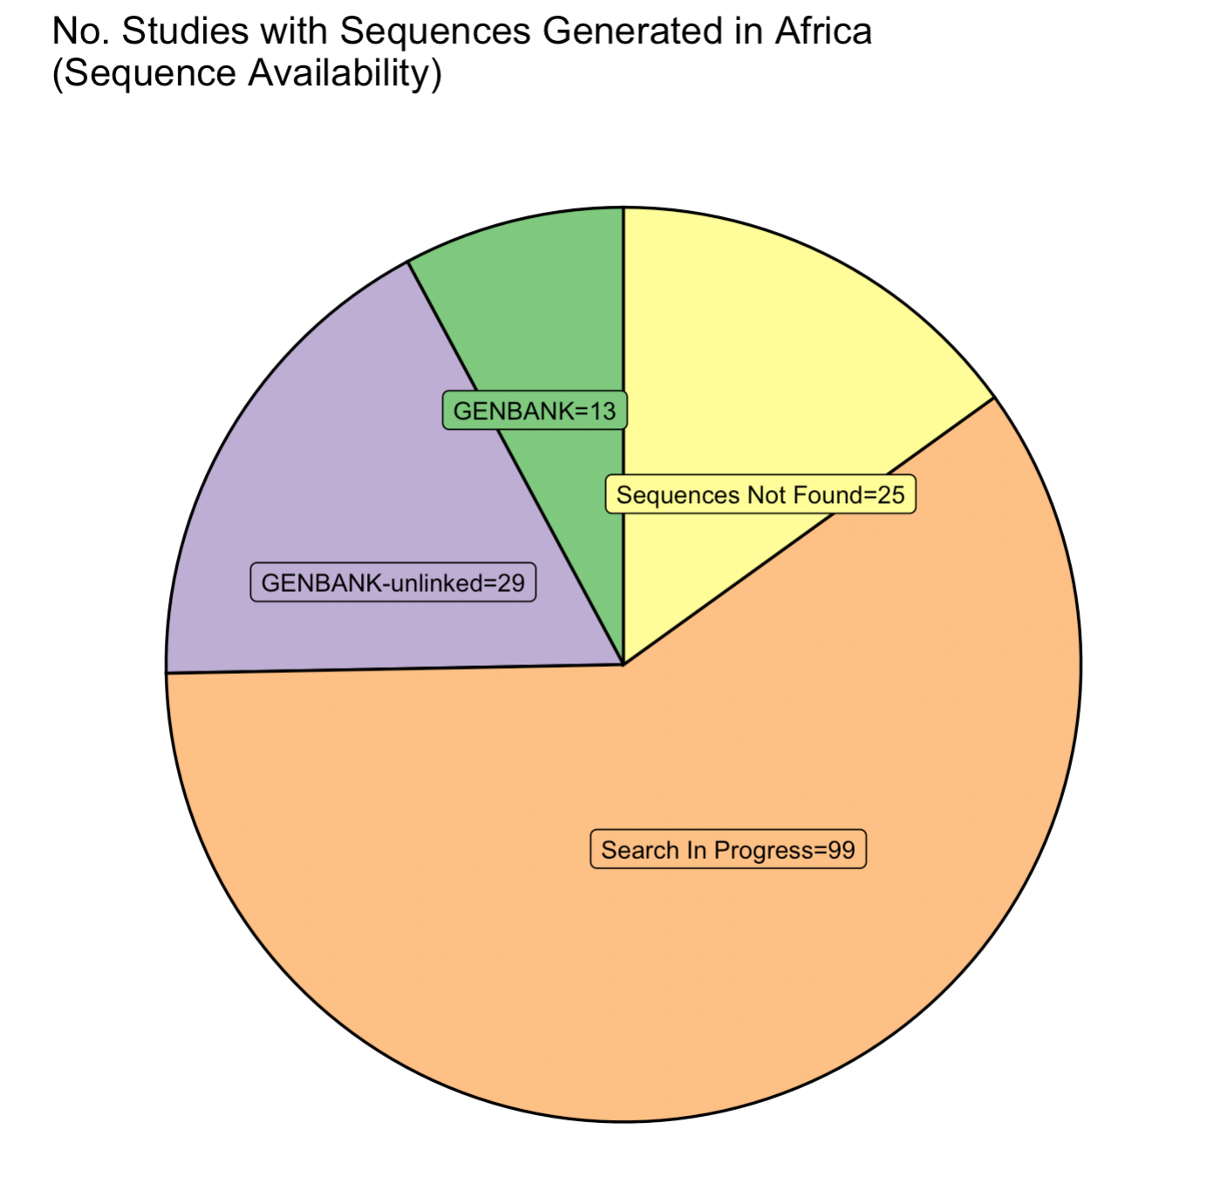
Review of arboviruses in Africa: Genomics
Preliminary

Slide 12
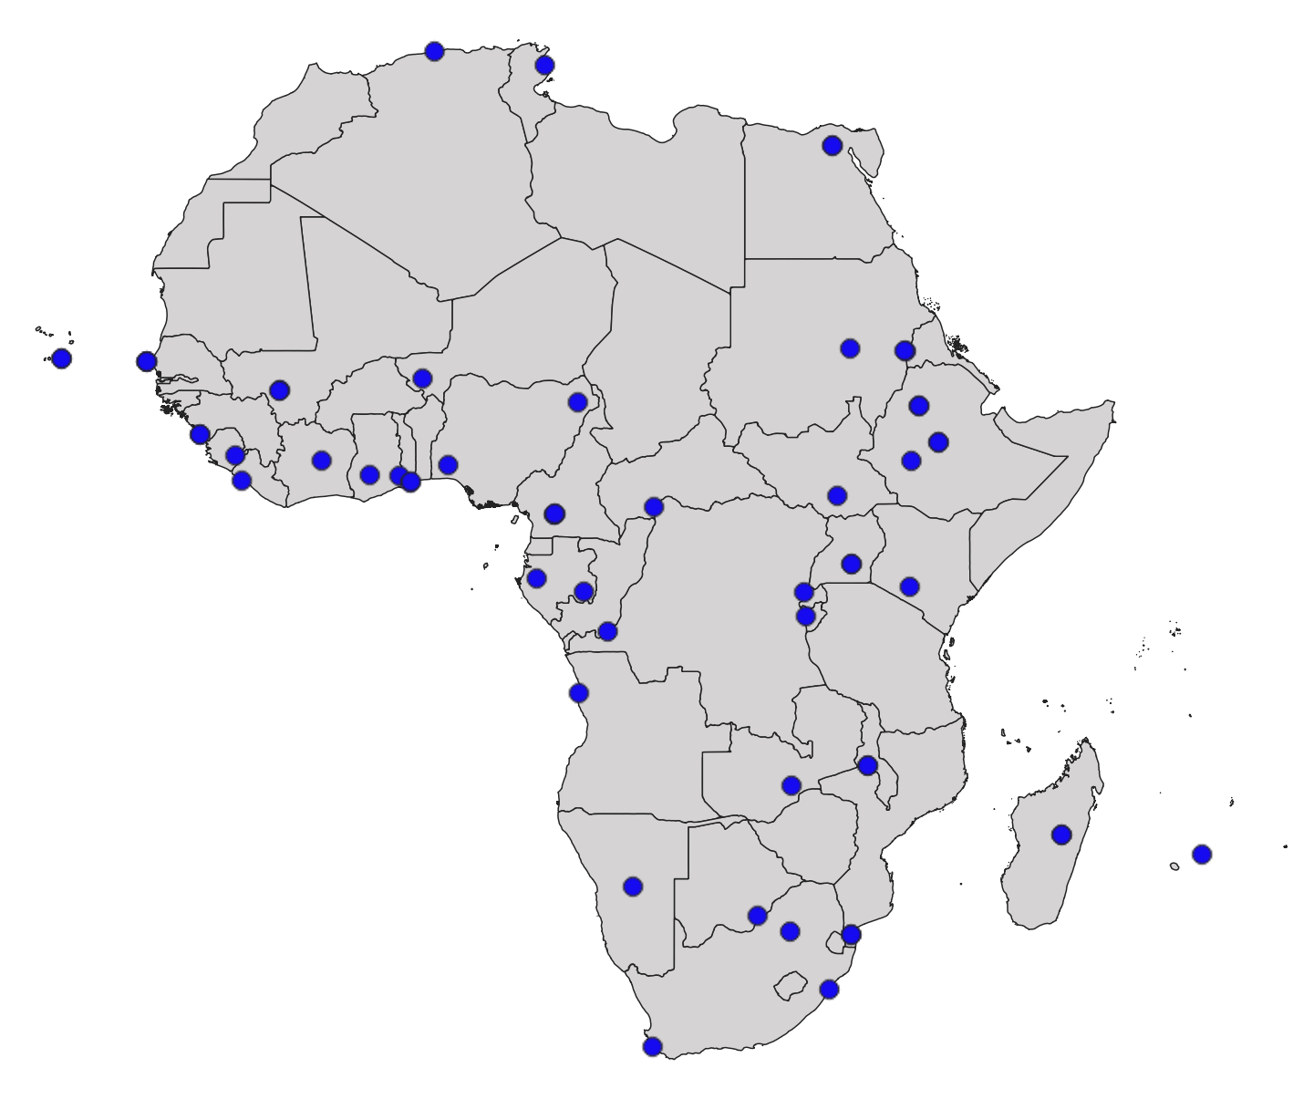
Questionnaire respondents
58 completed questionnaires

Slide 13
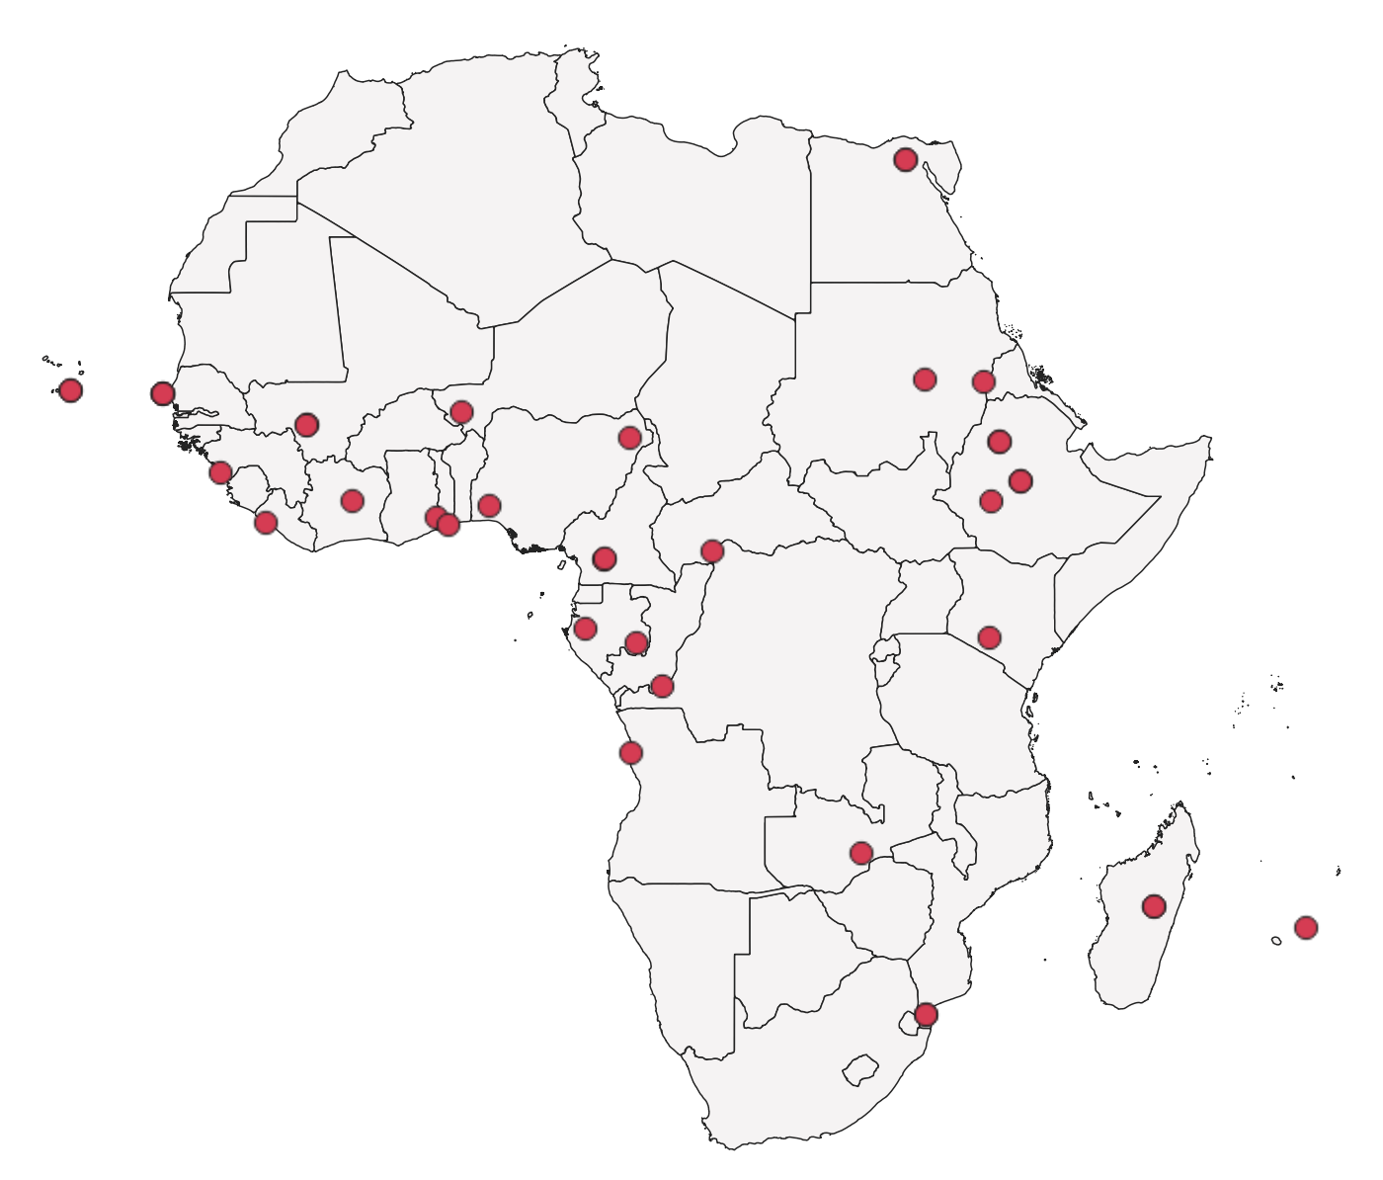
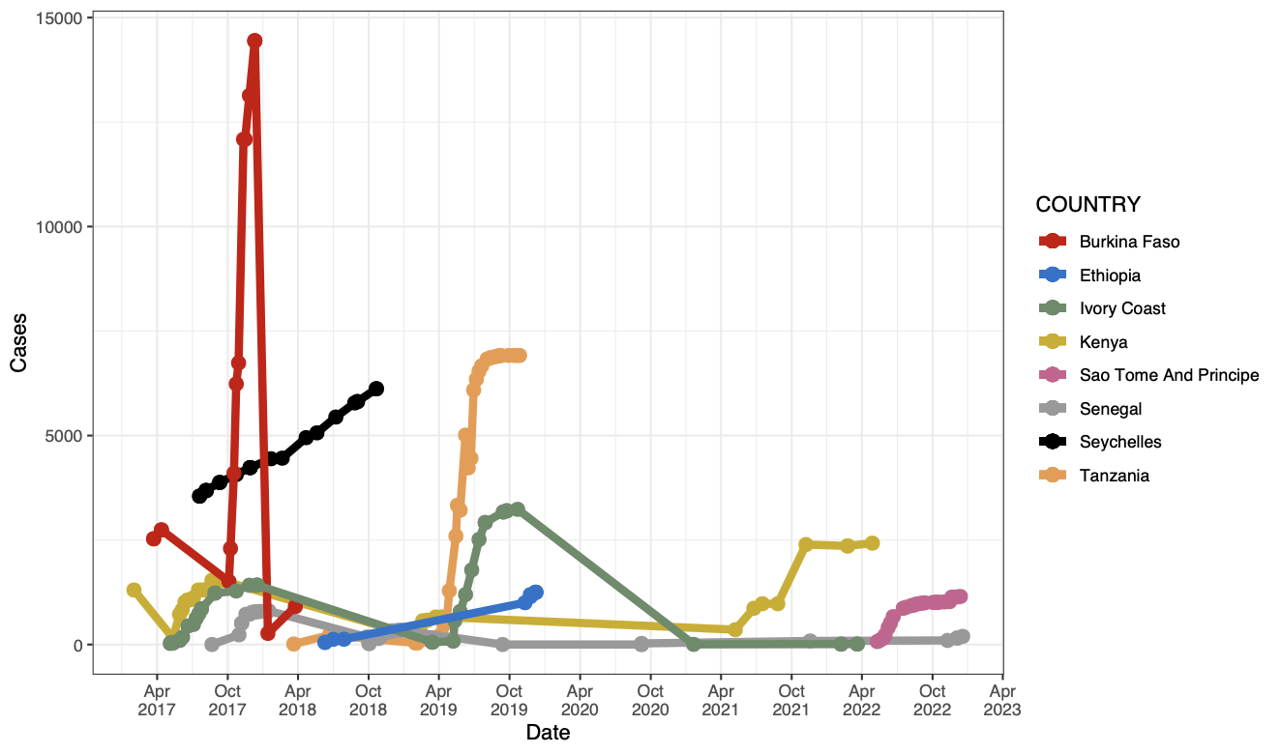
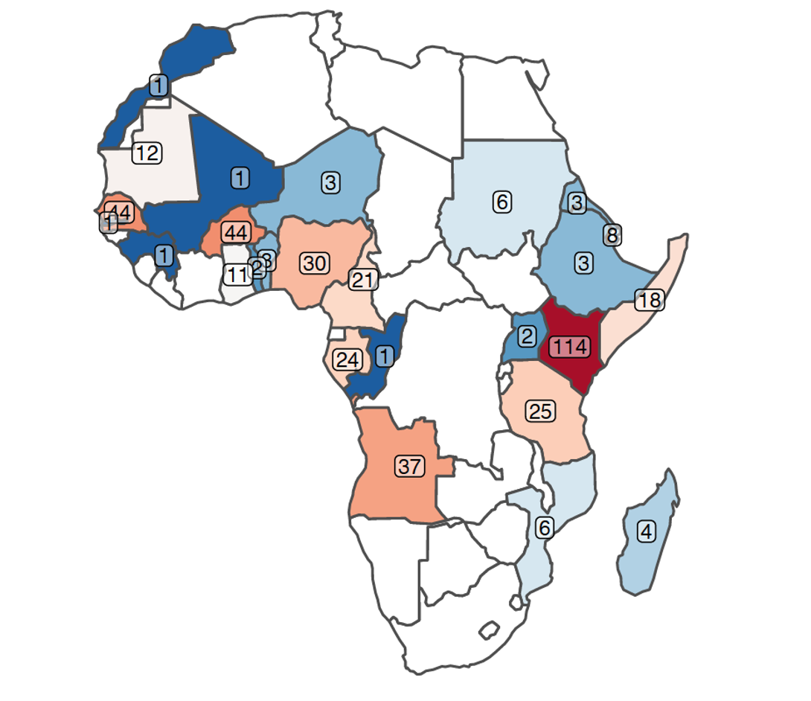
Dengue
WHO Afro reported cases
Occurrences
Genomes

Slide 14
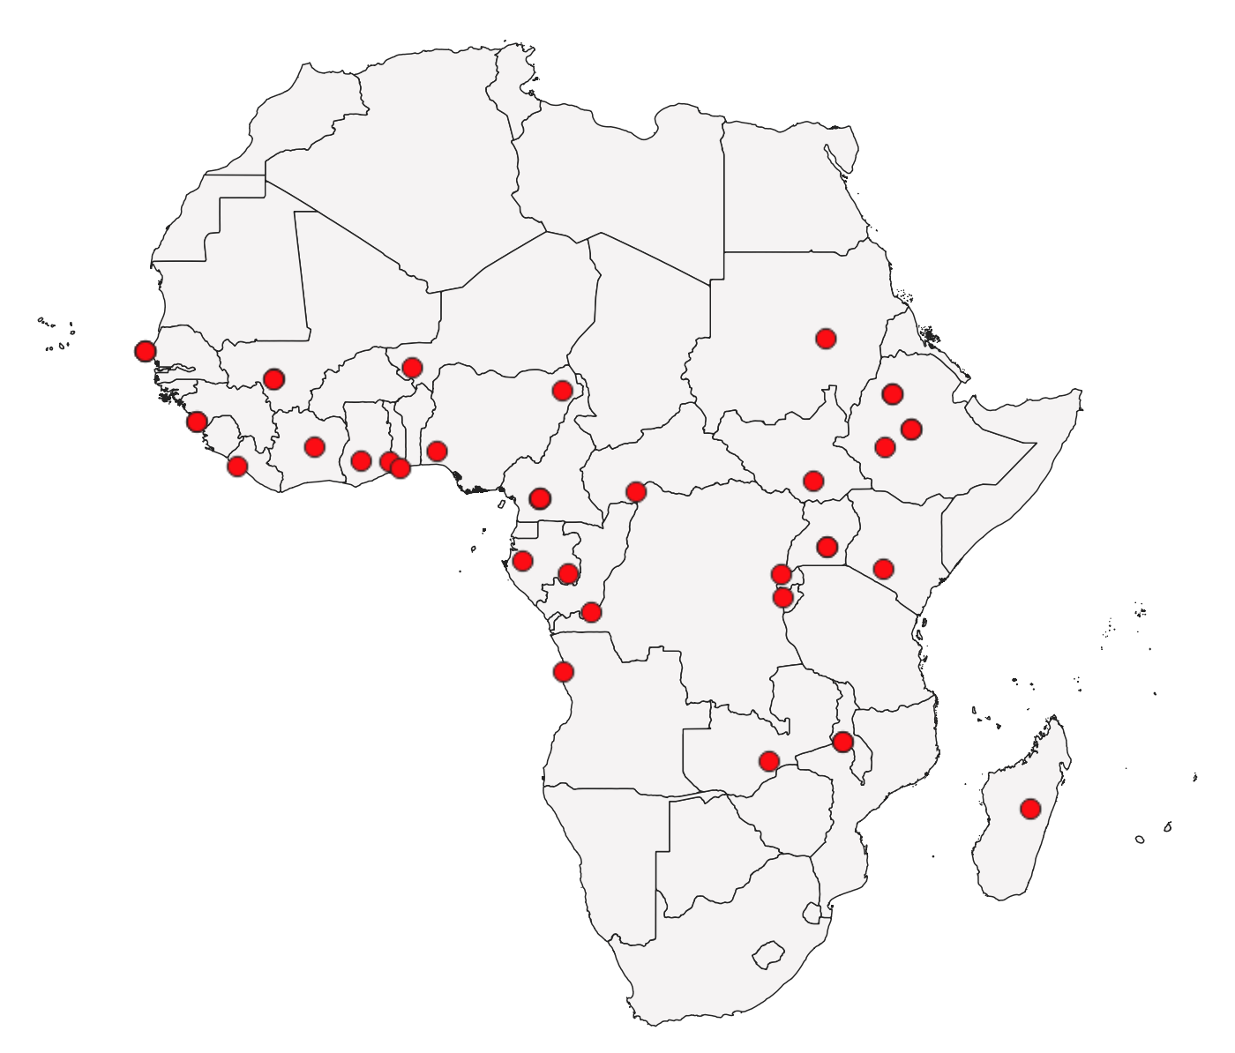
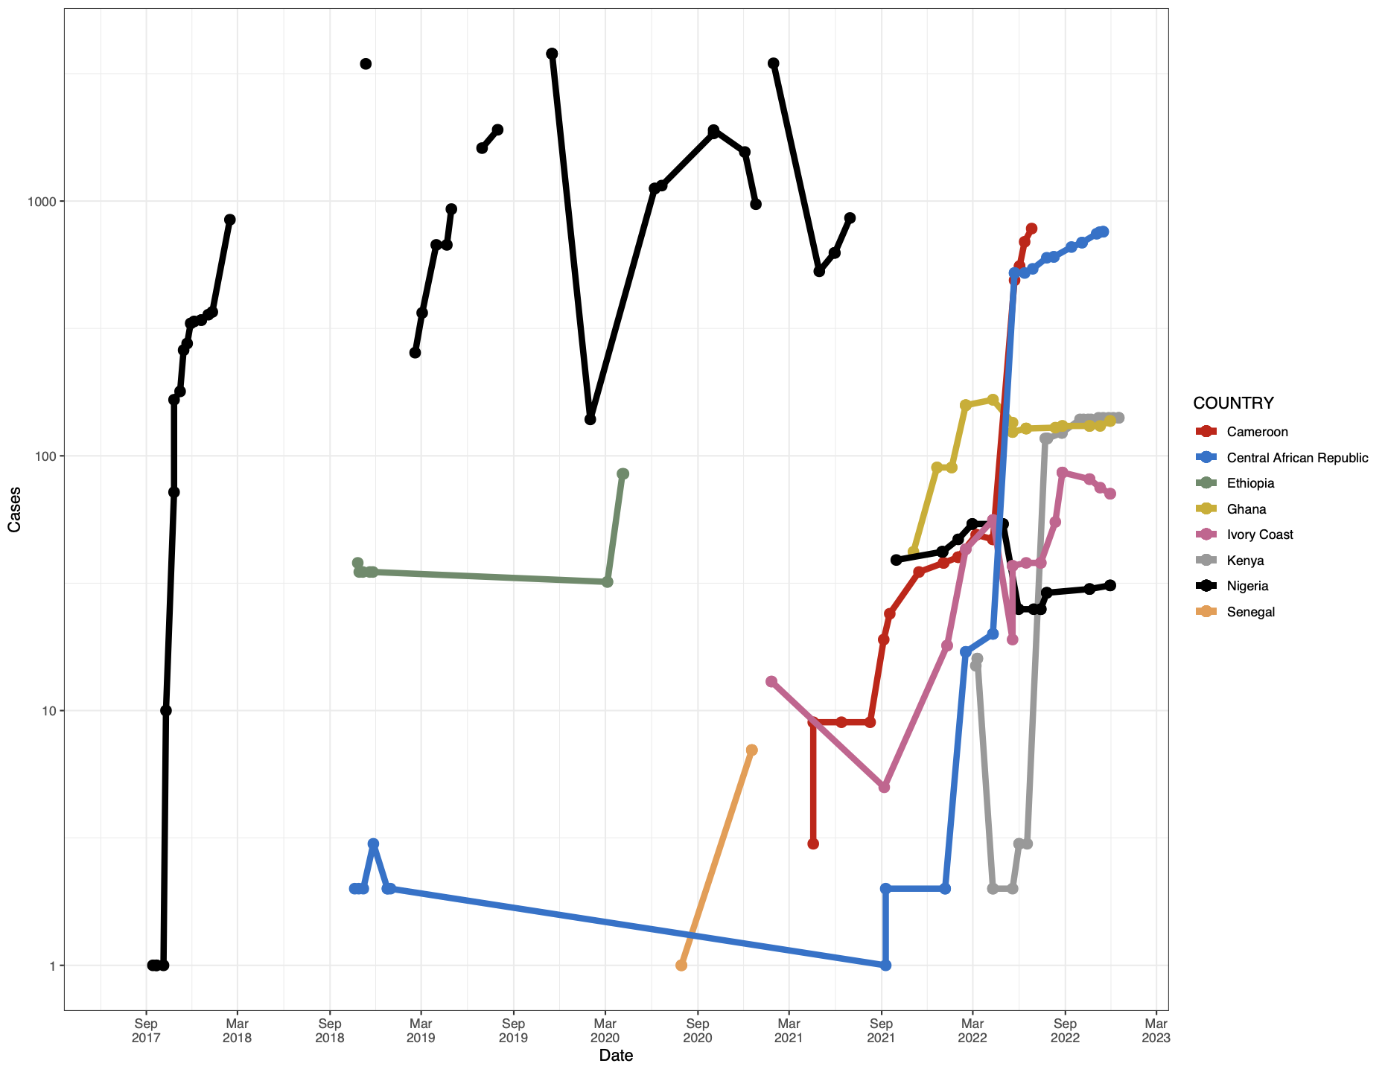
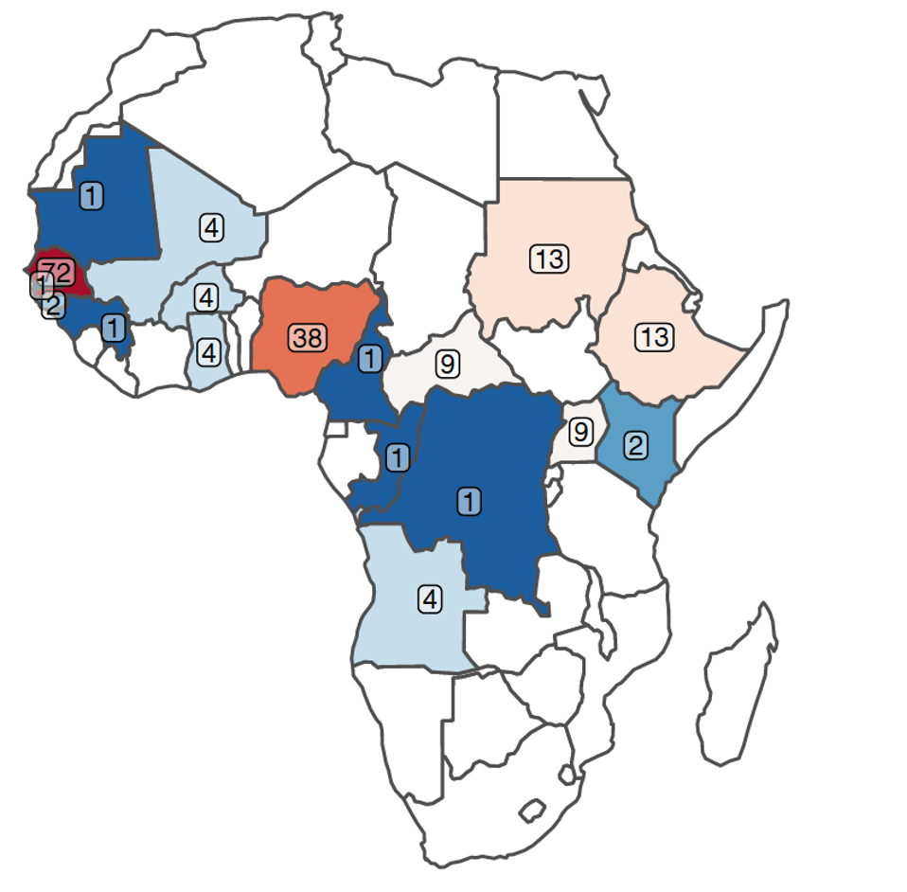
Yellow Fever
WHO Afro reported cases
Occurrences
Genomes

Slide 15
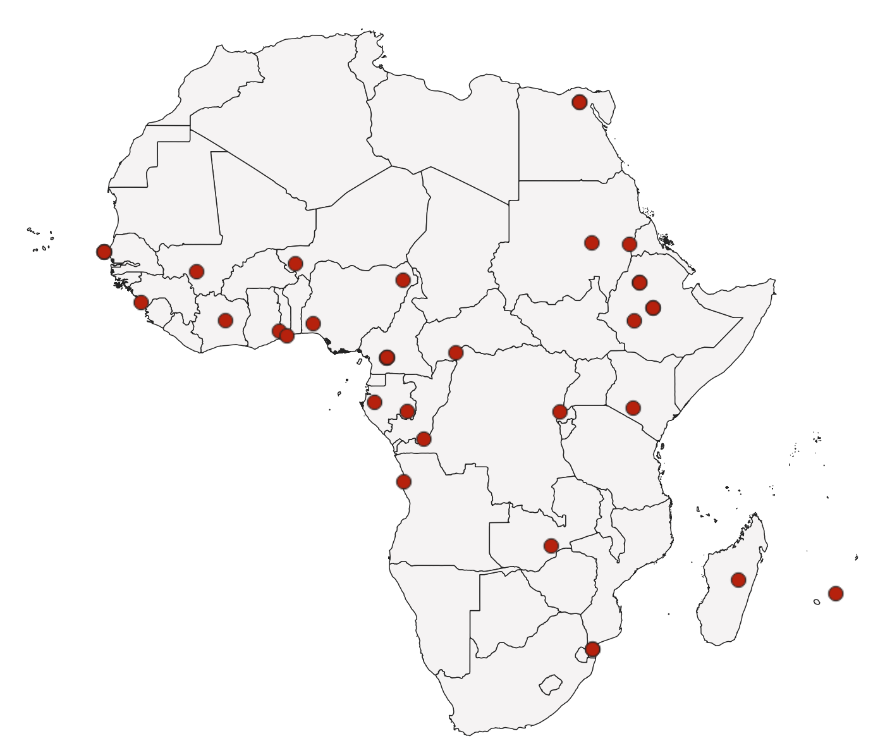
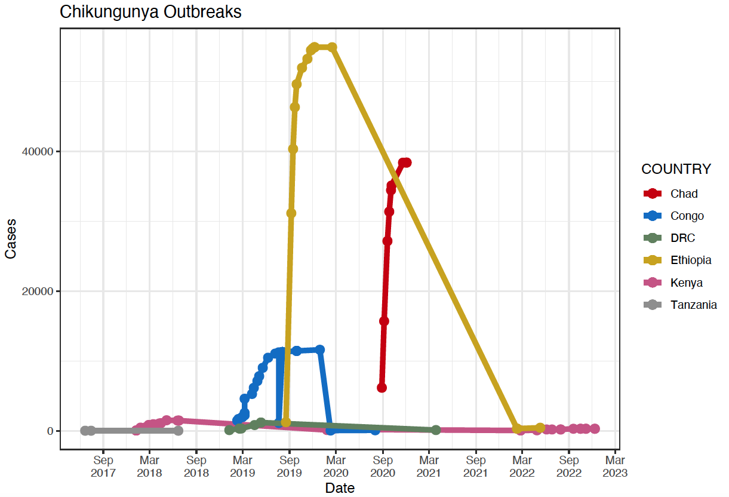
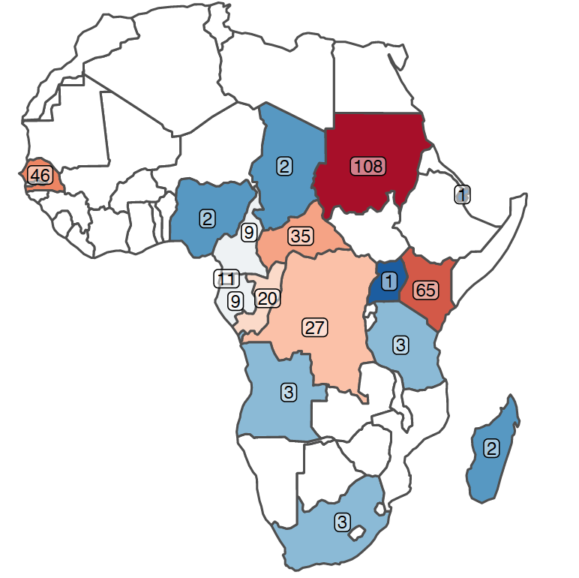
Chikungunya
WHO Afro reported cases
Occurrences
Genomes

Slide 16
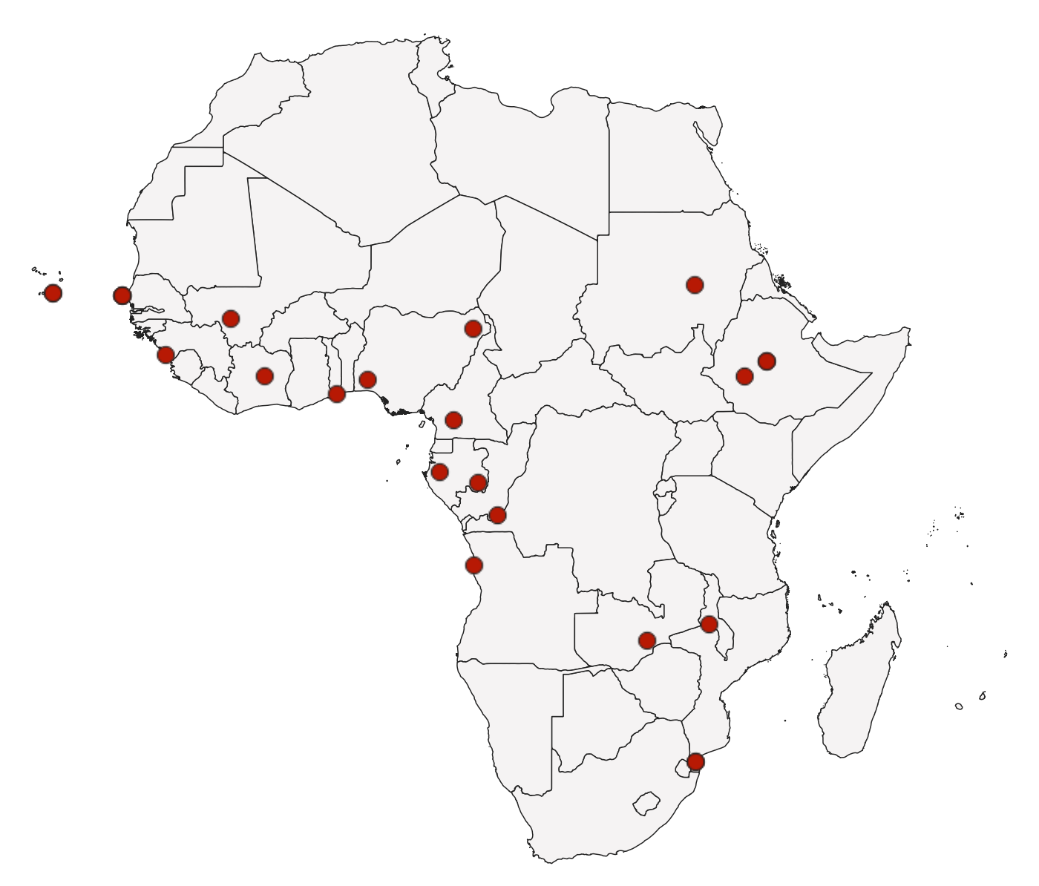
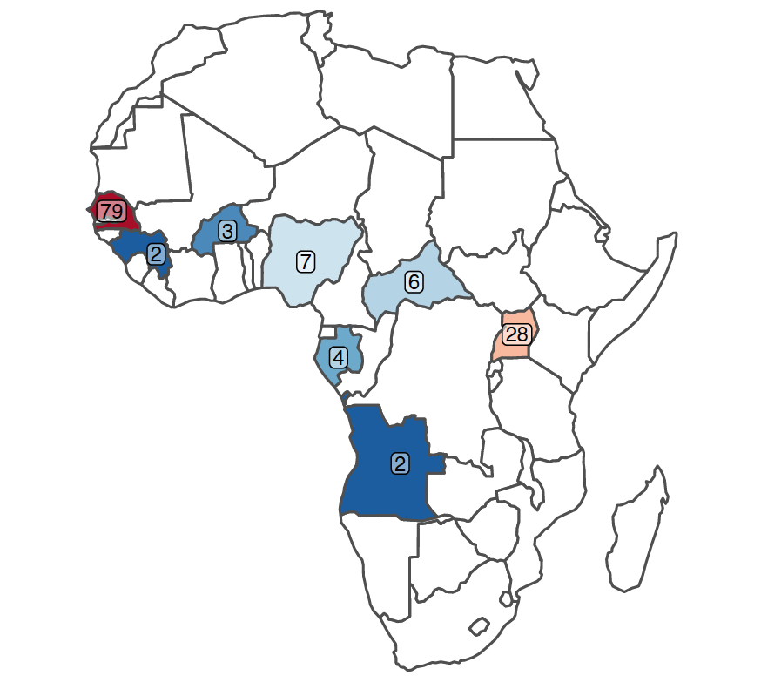
Zika
WHO Afro reported cases
3 Cases in Angola in 2017
Genomes
Occurrences

Slide 17
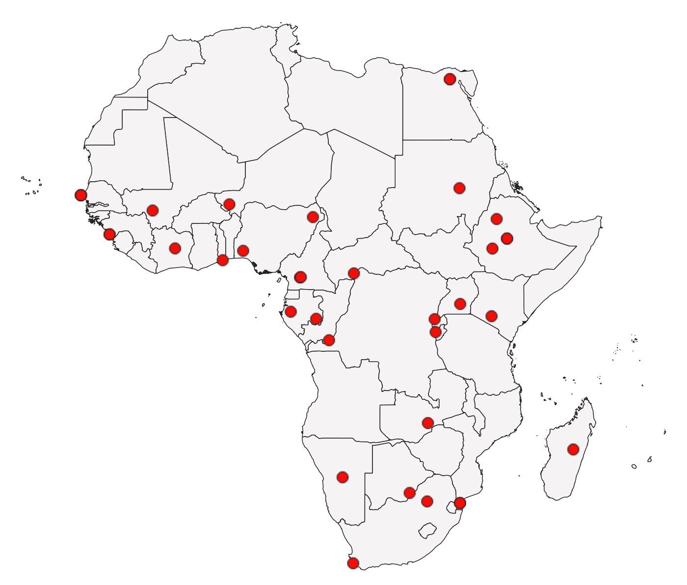
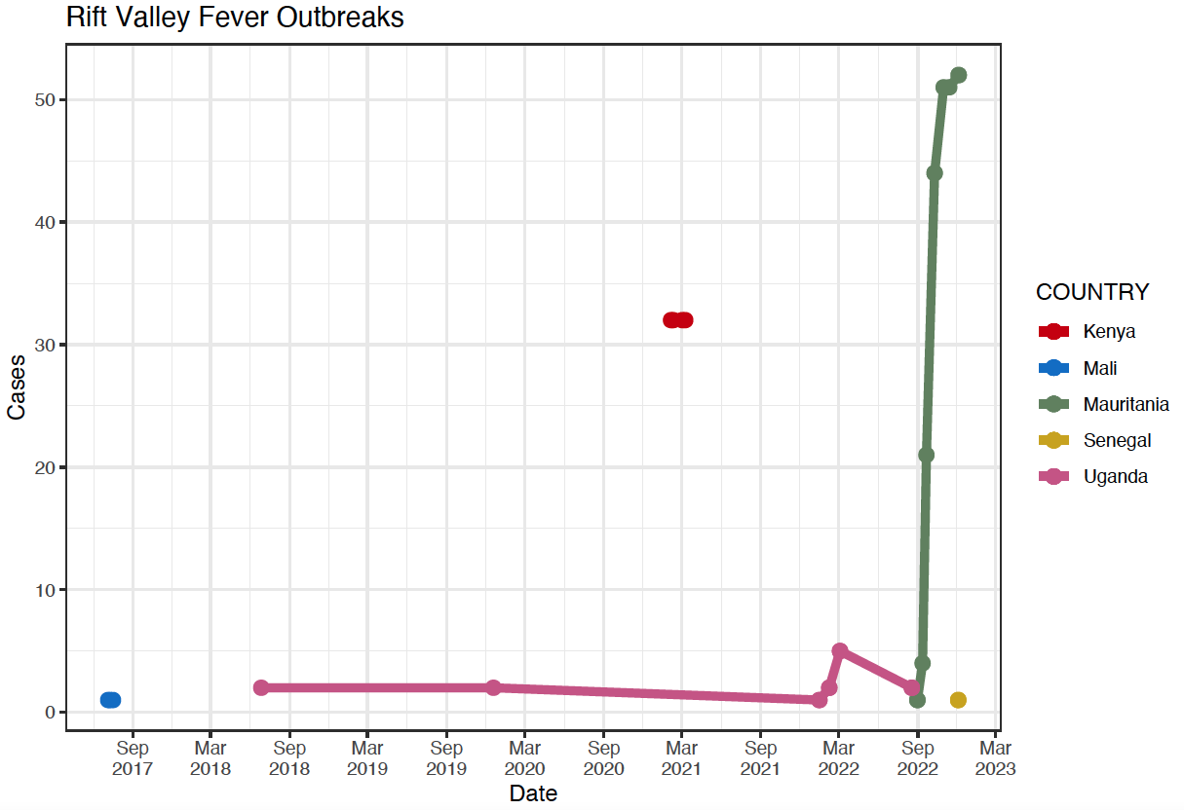
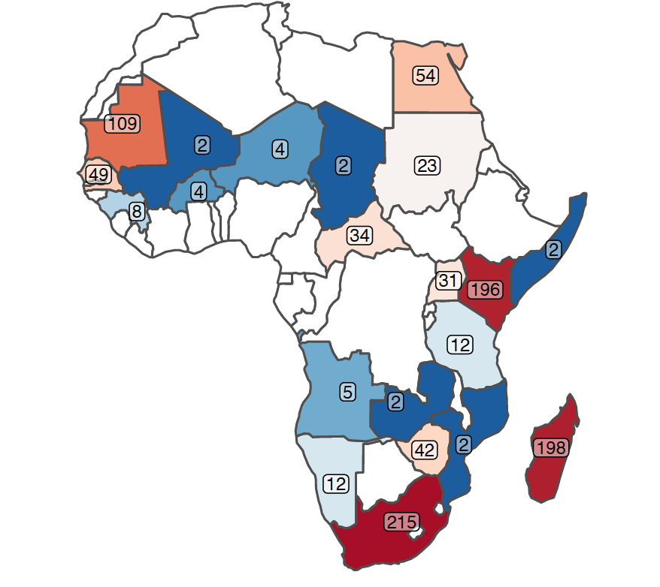
Rift Valley
WHO Afro reported cases
Occurrences
Genomes

Slide 18
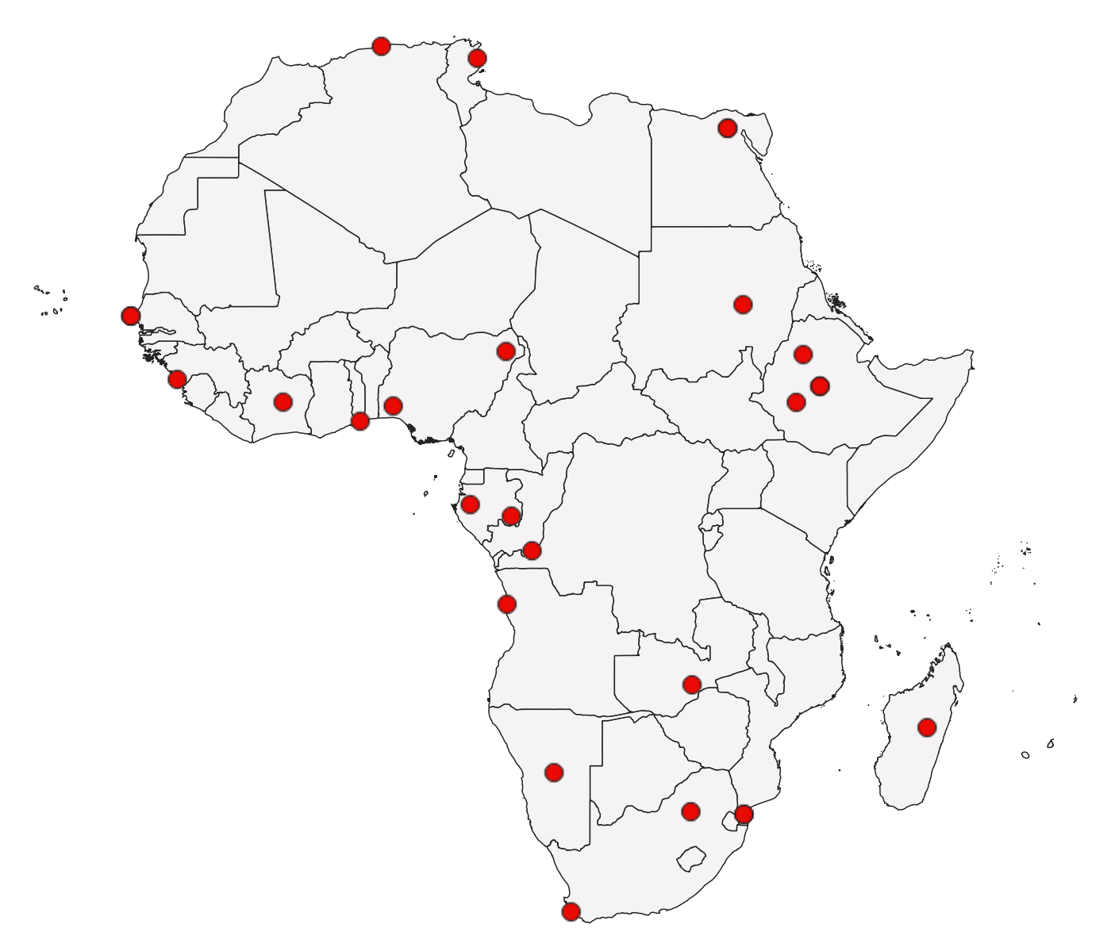
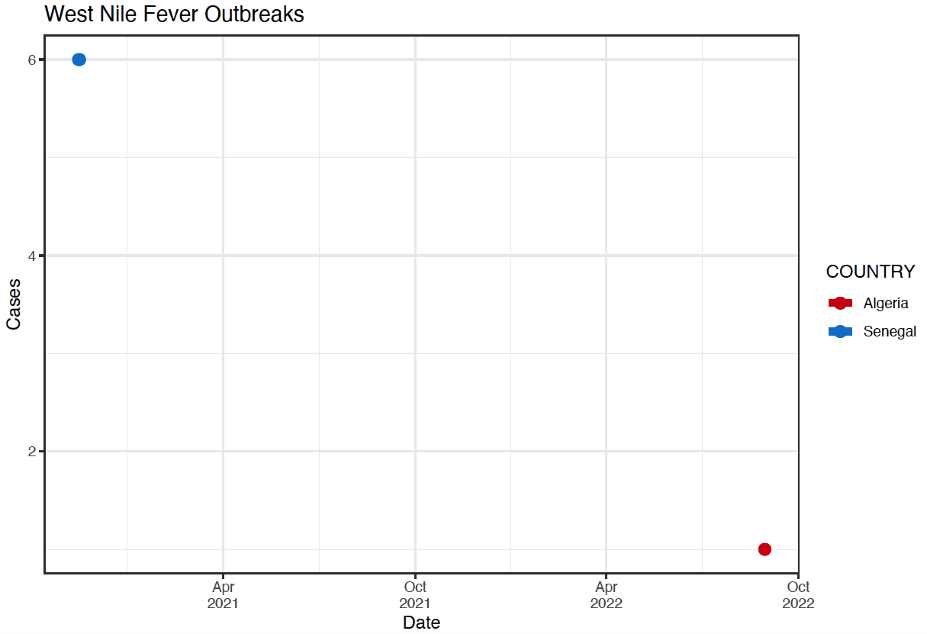
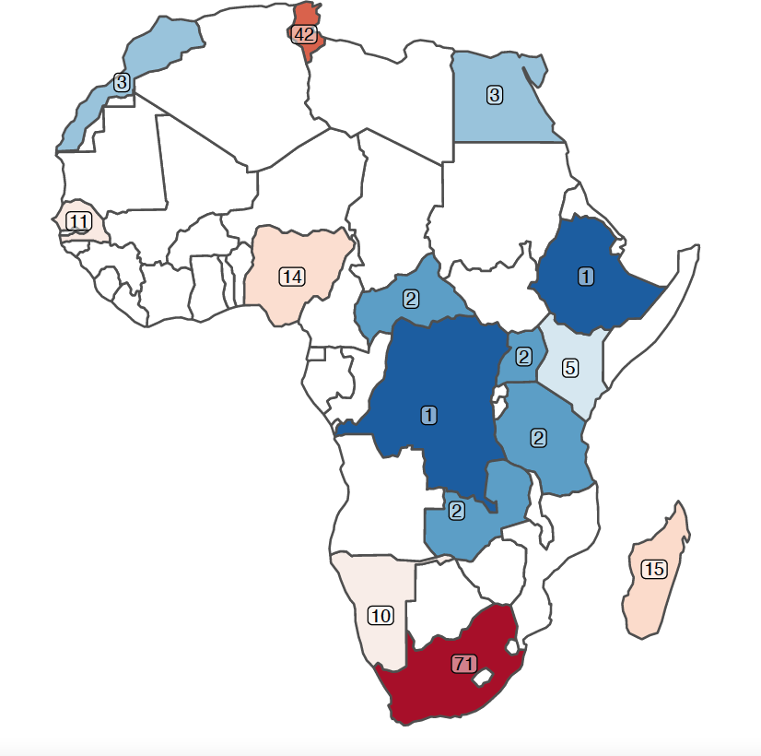
West Nile
WHO Afro reported cases
Occurrences
Genomes

Slide 19
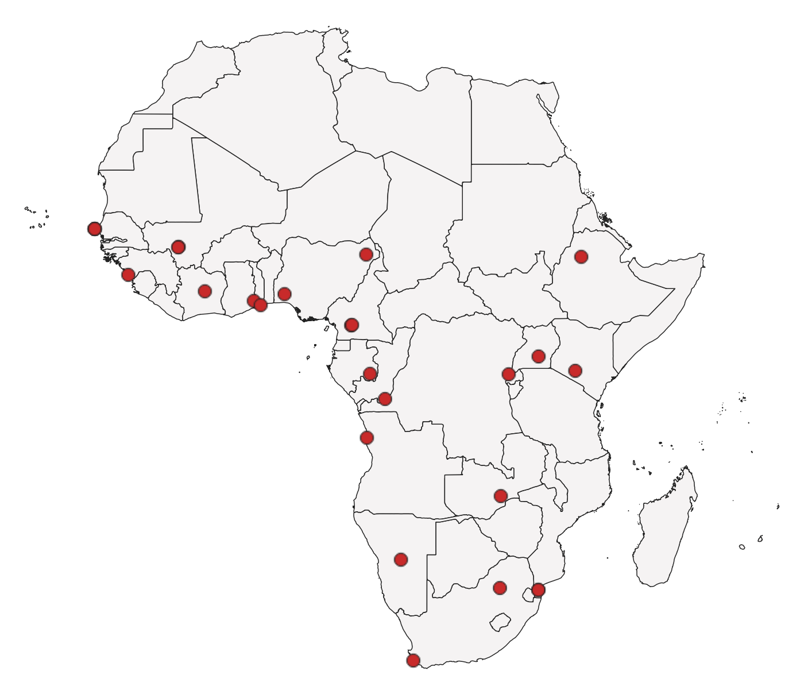
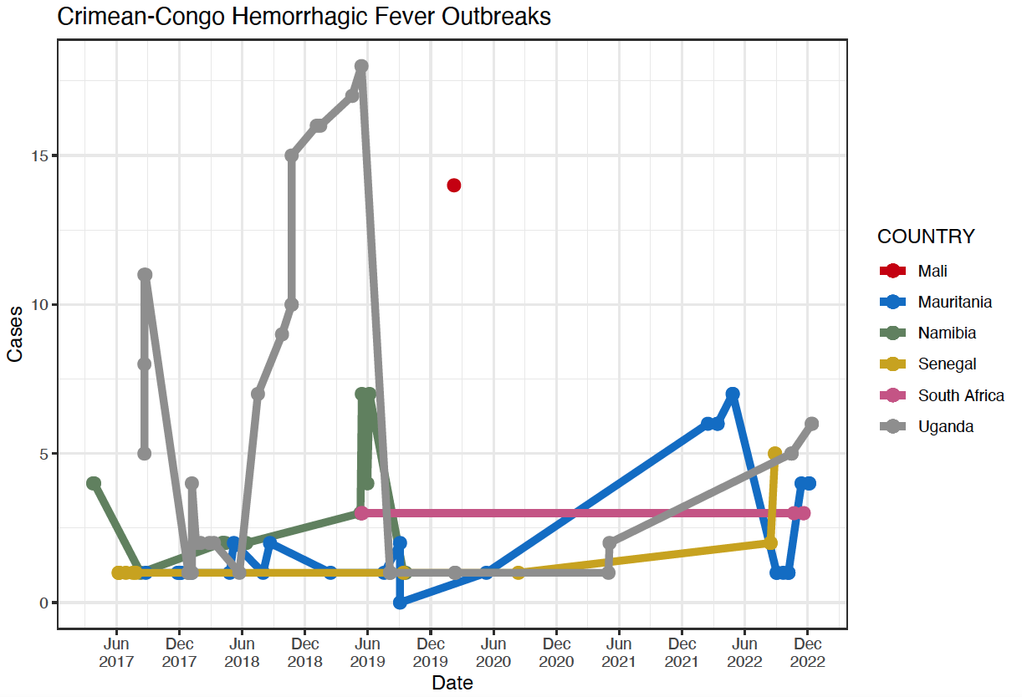
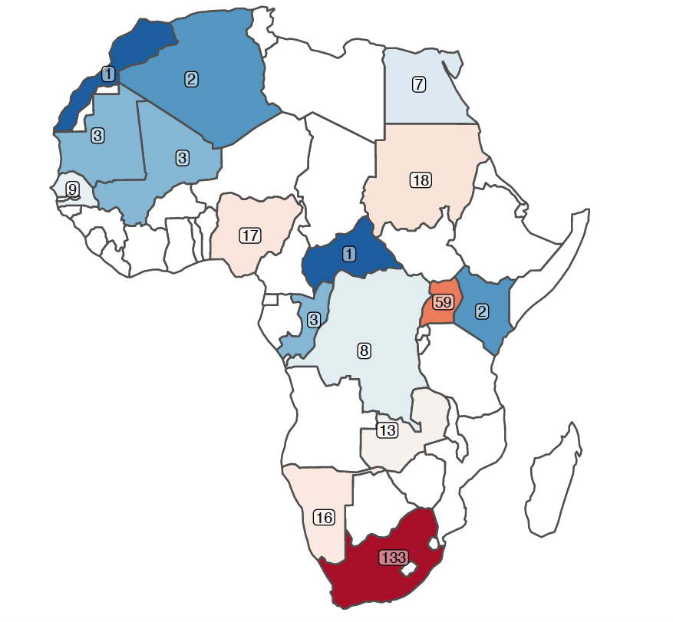
Crimean-Congo Hemorrhagic Fever
WHO Afro reported cases
Occurrences
Genomes

Slide 20
Key Arbovirus vectors
Virus | Vectors
Dengue | Ae. aegypti
West Nile | Cx. modestus, Cx. neavei, Cx. perexiguus, Cx. pipiens, Cx. quinquefasciatus, Cx. univittatus, Cx. theileri
Yellow Fever | Ae. aegypti, Ae. africanus, Ae. albopictus, Ae. furcifer/taylori, Ae. leucocelaenus, Ae. luteocephalus, Ae. metallicus, Ae. opok, Ae. simpsoni complex, Ae. vittatus, Haemagogus capricorni, Haemagogus equines, Haemagogus janthinomys, Haemagogus leucocelanus, Haemagogus mesodentatus, Haemagogus spegazzinii, Sabethes chloropterus
Zika | Ae. aegypti, Ae. africanus, Ae. albopictus, Ae. furcifer, Ae. jamoti, Ae. opok, Ae. flavicollis, Ae. grahami, Ae. taeniorostris, Ae. tarsalis, Ae. vittatus, Ae. dalziella, Ae. fowleri, Ae. luteocephalus, Ae. metallicus, Ae. minimus, Ae. neoafricanus, An. gambiae, Eretmapodites inornatus, Eretmapodites quinquevittatus, Mansonia uniformis
Chikungunya | Ae. aegypti, Ae. africanus, Ae. albopictus, Ae. cordellieri, Ae. furcifer, Ae. fulgens, Ae. luteocephalus, Ae. neoafricanus, Ae. taylori, Ae. vittatus
Rift Valley | Ae. aegypti, Ae. caballus, Ae. cumminsii, Ae. circumluteolus, Ae. dentatus, Ae. juppi, Ae. mcintoshi, Ae. ochraceus, Ae. pembaensis, An. squamosus, Cx. bitaeniorhyncus, Cx. quinquefasciatus, Cx. poicilipes, Cx. theileri, Cx. univittatus, Cx. zombaensis, Eretmapodites quinquevittatus, Mansonia africana, Mansonia uniformis
Crimean-Congo Hemorrhagic Fever | Ticks of the genus Hyalomma
Braack, L., Gouveia de Almeida, A.P., Cornel, A.J. et al. Mosquito-borne arboviruses of African origin: review of key viruses and vectors. Parasites Vectors 11, 29 (2018). https://doi.org/10.1186/s13071-017-2559-9

Slide 21
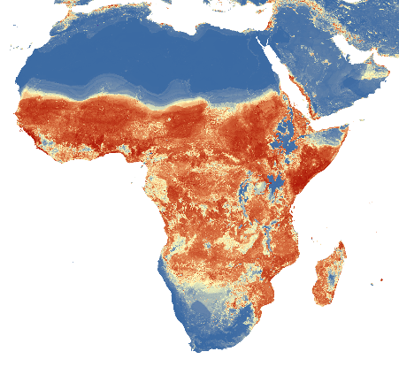
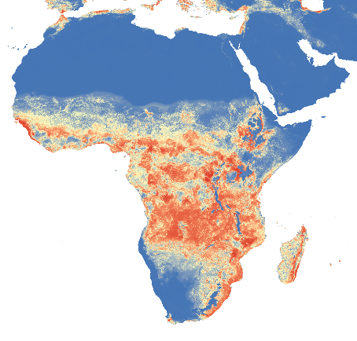
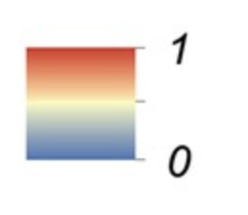
Distribution of arbovirus vectors in Africa
Ae. aegypti Distribution Map
(Transmits: Dengue, Yellow Fever, Zika, Chikungunya)
Ae. albopictus Distribution Map
(Transmits: Zika, Chikungunya)
probability of occurrence
Moritz UG Kraemer, et al. (2015) The global distribution of the arbovirus vectors Aedes aegypti and Ae. albopictus eLife 4:e08347.
https://doi.org/10.7554/eLife.08347

Slide 22
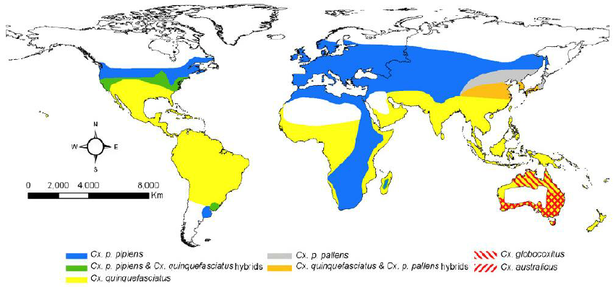
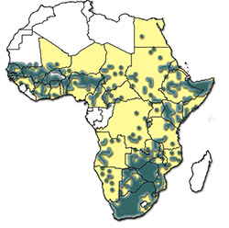
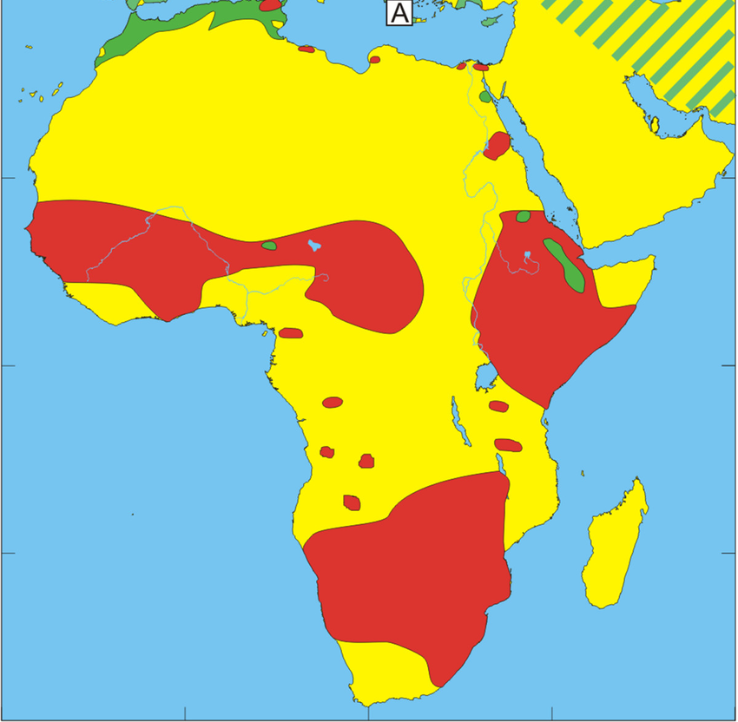
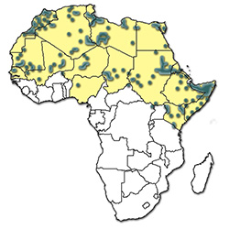
Distribution of arbovirus vectors in Africa
Cx. pipiens Distribution Map
(Transmits: West Nile)
Hyalomma Ticks Distribution Map
(Transmits: Crimean-Congo Hemorrhagic Fever)
Hyalomma marginatum (green)
Hyalomma rufipes (red)
Hyalomma truncatum
Hyalomma dromedarii
Ciota AT, Kramer LD. Vector-Virus Interactions and Transmission Dynamics of West Nile Virus. Viruses. 2013; 5(12):3021-3047. https://doi.org/10.3390/v5123021
Wallménius, K., Barboutis, C., Fransson, T. et al. Spotted fever Rickettsia species in Hyalomma and Ixodes ticks infesting migratory birds in the European Mediterranean area. Parasites Vectors 7, 318 (2014). https://doi.org/10.1186/1756-3305-7-318
https://www.afrivip.org/sites/default/files/Ticks-importance/hyalomma/

Slide 23
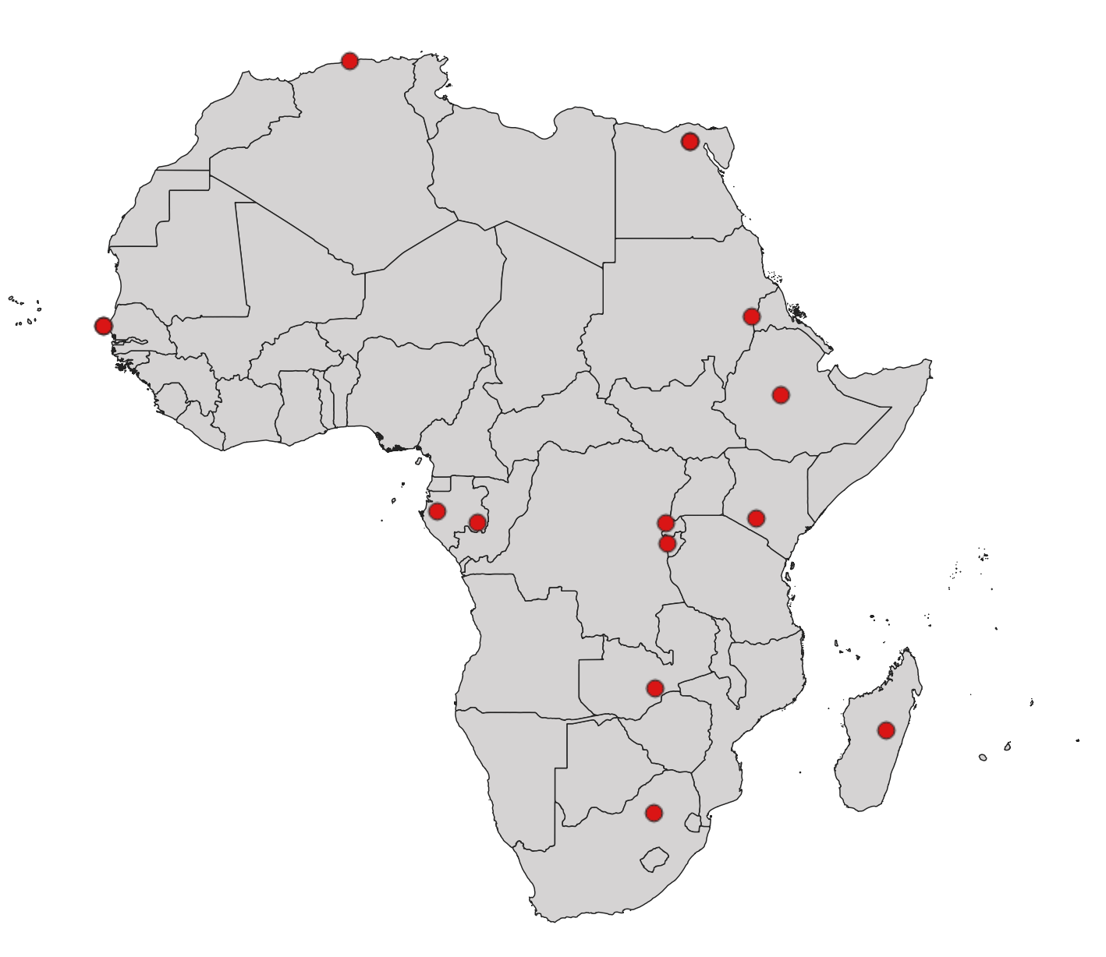
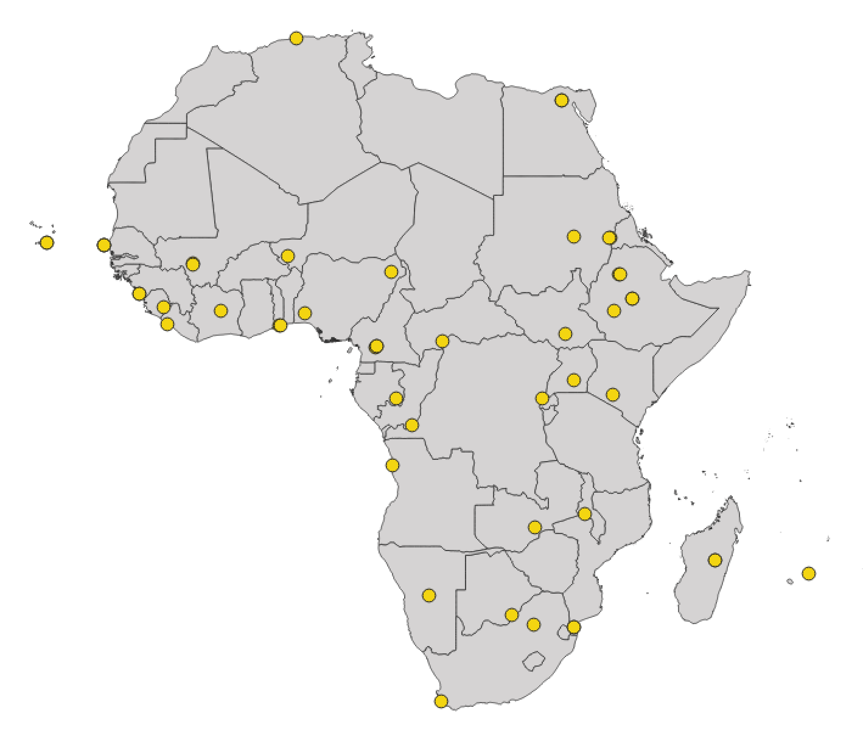
Questionnaire responses - Institutions
Institutions
Currently sequencing
Access to stored samples

Slide 24
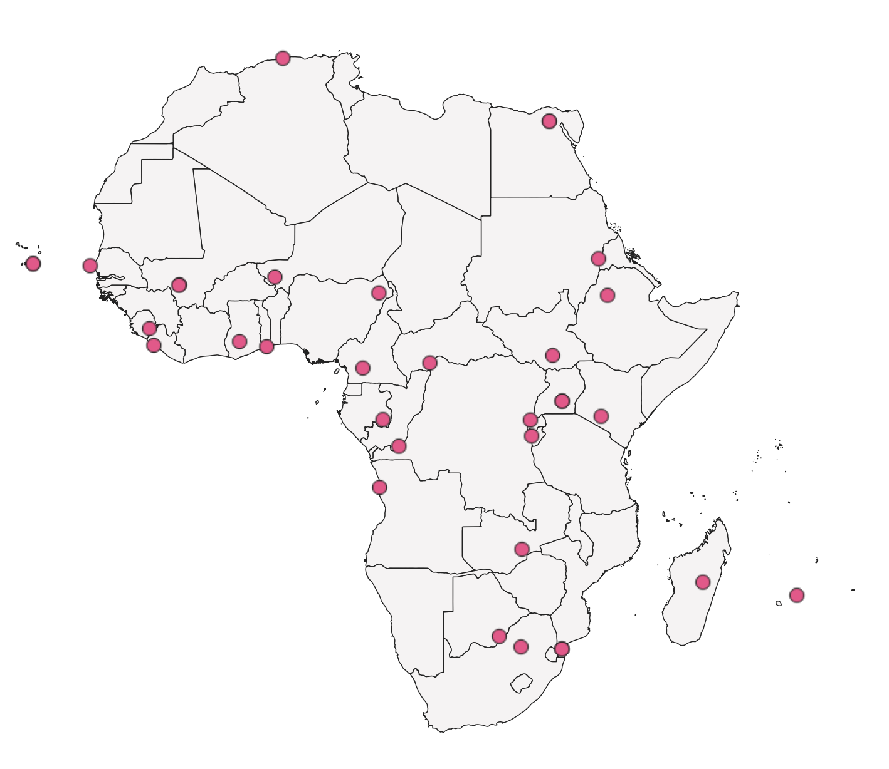
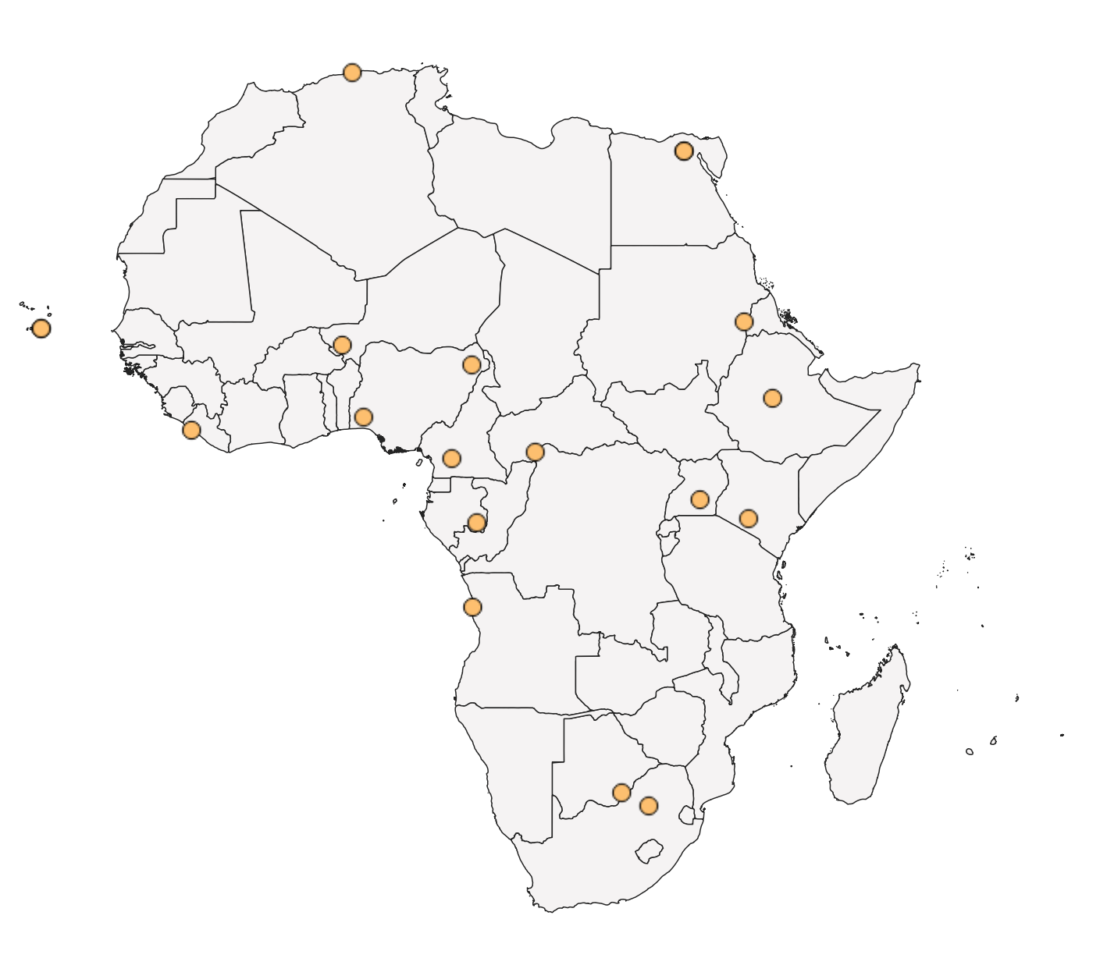
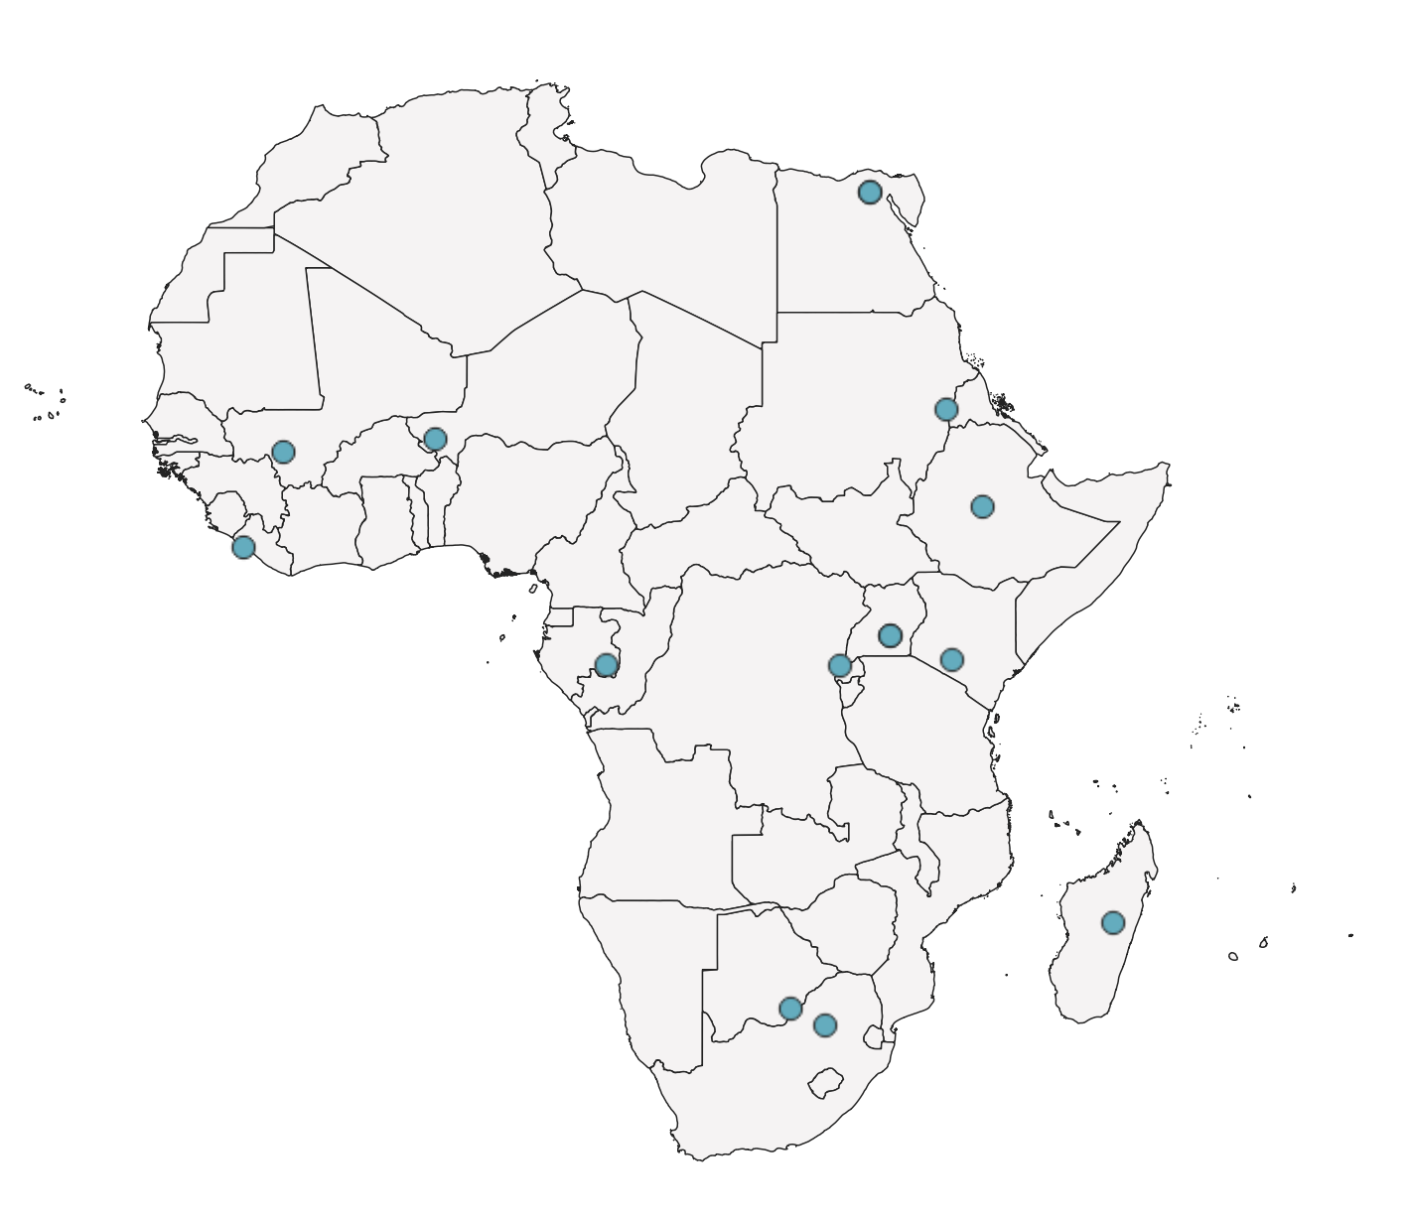
Questionnaire responses - Country
Human
Vector
Animal

Slide 25
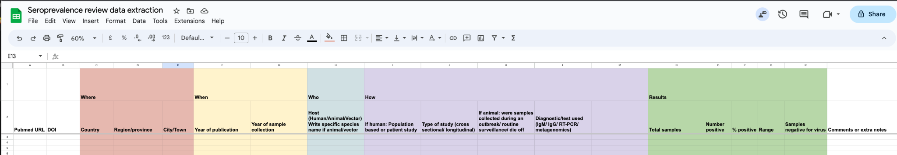
Next steps
Identify and contact institutions that are currently unable to sequence
Identify and contact institutions with stored samples requesting sequencing
Understand challenges and needs of institutes
Extract seroprevalence data
Summarize genomic data from publications
Source case data from country partners to complement WHO outbreak reports data

Slide 26
ACKNOWLEDGEMENTS
Literature Review
Dr. James E. San, Yajna Ramphal, Martina Reichmuth, Dr. Marije Hofstra, Dr. Eduan Wilkinson
WHO Outbreak Data Curation
Dr. James E. San, Yajna Ramphal, Akhil Maharaj
Questionnaires
CLIMADE-Africa partners that have filled in the relevant questionnaire
Groups in Africa that have made their genomic data available publicly on Genbank

Slide 27
Thank you
Centre for Epidemic Response and Innovation (CERI), Stellenbosch University https://ceri.org.za | https://climade.health | Twitter: @tuliodna

